Slide 1

My Experience at UC Berkeley
Jianqin Wang
Visiting Student
The Cooper Union for the Advancement of Science and Art
Intern Outreach Presentation, Berkeley
July 27, 2015

Slide 2
Project
NGA-Subduction with Dr. Tadahiro Kishida
Data processing for Alaska earthquake recordings
Filtering/Baseline correction of recordings
Process RotD Calculations
Categorize earthquake type
Combine info

Slide 3
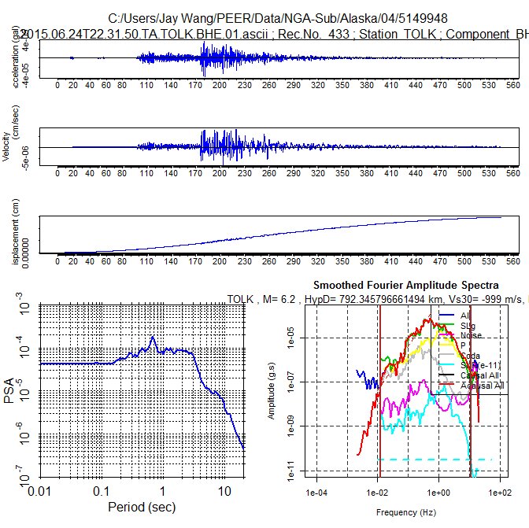
Filtering Recordings
Acceleration
Velocity
Without filter, the original time series show large displacements
Displacement
Response Spectra
Fourier Spectrum

Slide 4
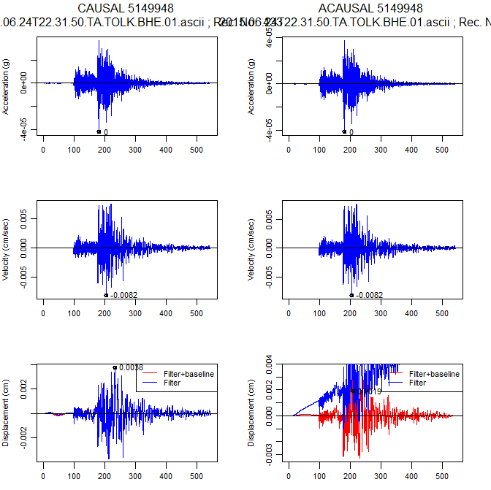
Filtering Recordings
After filtering and baseline correction, the time series show a realistic displacement.

Slide 5
Categorize Earthquake types
Earthquakes are categorized based on the hypocenter locations.
Subduction Interface
Subduction Intraslab
Subduction Outer Rise
Shallow Crustal

Slide 6
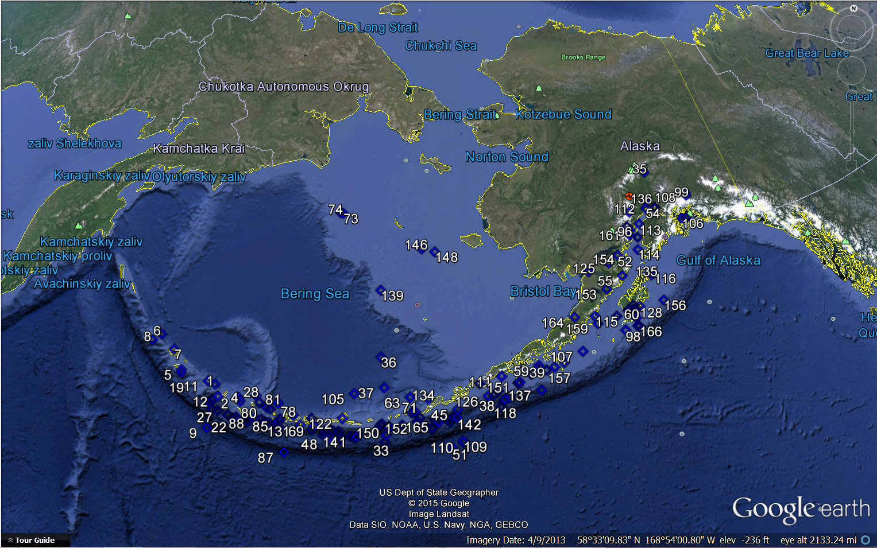
More than 140 large earthquake events are reviewed from Alaska to Aleutian Islands. More than 7,500 records were processed from these events.

Slide 7
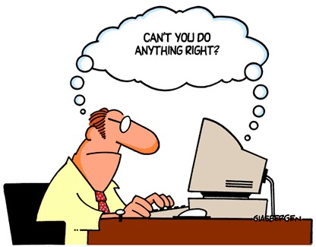
Combine Info
Different databases are combined.
Ground motion database (PGA, PGV, PSA etc.)
Site database (Station coordinates, site condition, instrument type, etc.)
Source database (Earthquake name, location, magnitude, fault information, event type etc.)
Key Challenge: Learning R and Using R
Notes:
Since I had no prior experience, the first few times trying to write code was frustrating, to say the least. Dr. Tadahiro patiently guided me for the first few code projects, and has never hesitated to give any help. I relied heavily on reading documentations on functions as well as google to correctly write code to process, extract, combine, and sort data. I also learned to be more patient, as debugging code can be very stressful; sometimes even the smallest mistake

Slide 8
Takeaway thoughts
How this internship has helped me, both professionally and personally
How I will apply this knowledge in the future
Lessons learned
Notes:
-This internship has helped me become
-I hope to continue research for my graduate studies, so hopefully I can continue to apply all the skills I have learned here at Berkeley this summer.
-I am more familiarized with R now, which will be useful since most research projects will involved processing and analyzing large quantities of data. Before this summer I probably would’ve had to rely heavily on excel, which is inefficient and not as powerful as R.

Slide 9
Acknowledgements
I would like to thank Dr. Tadahiro Kishida for all of his help and patience.
I would like to thank PEER and UC Berkeley for this opportunity this summer.
I would like to thank Sahar Derakhshan for her help as well.

